Slide 1
Web Browser Forensics
Project Phase - II Presentation
on
Presented By
Mayur R. Jadhav
(162050022)
Guided By
Dr. B. B. Meshram

Slide 2
Content
Introduction
Sources of Browser’s Data
Statement of the problem
Block Diagram
Propose System Modules
Literature Details
Recovery method for deleted information in Web browsers
Locations of Internet Browser Artifacts
Flow of System
Existing Tools
Implementation Screenshots
References

Slide 3
Background & motivation

Slide 4
Introduction Sources Of Browser’s Data
Surfing history: User internet surfing history
Bookmarks: Tis are the saved pages and links we may ant to used in future.
Download: This are data related to the downloaded content by user.
Cookies: This are the user history logs used to get History from long period of time. It stores username and password.
Cache: This is the recent surfing history of user. It is around 3 MB of memory.

Slide 5
Statement of the problem
a. Forensics of browser to collect all local and server based evidences-
Browser contain most of the information about user so collect and find all evidences present in Browser History, Cookies, and LOG files and present it properly.
b. Apply Forensics on collected evidences and find criminals information and generate reports.

Slide 6
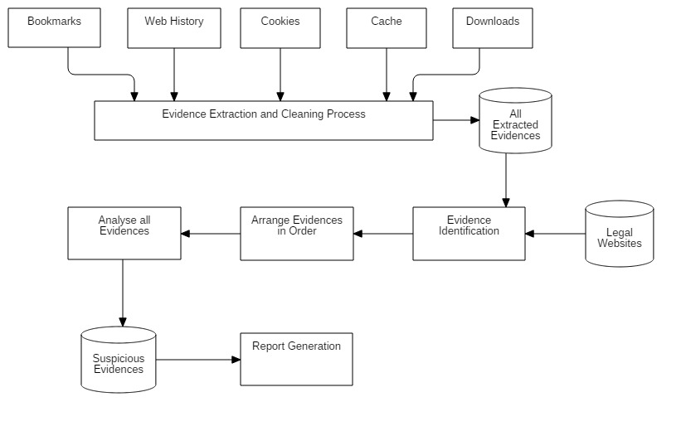
Propose System Diagram

Slide 7
Propose System Modules
Collecting evidences from different sources
Apply Cleaning Process on that evidences remove ambiguous data
If data is deleted then recover that data
Stored all evidences in Proper format
Identify the legal evidences
Arrange all evidences in proper order
Analyze all evidences and find suspicious evidences
Generate the report of Criminals information

Slide 8
Literature Details

Slide 9
Recovery method of history in Web browsers
Use DNS Cache to find and view deleted browsing history: DNS, which is known as Domain Name System, can work as a fast method to restore searches or history for you. But when computer is restarted, it will not be able to help you find browsing history then. DNS cache can only work when almost everything is connected to the internet.
Use data recovery software to recover lost browsing history files
Type I: Using User File System
Type II- Using Browser Cookies
Recover deleted browsing history from Google History: If you have Google Account and logged in everything when you browse websites, you will have a great chance to find and recover browser/internet history. When deleted history from browsers, the Google History is not deleted. It will store all browsing history including all pages that you’ve ever visited and even devices attached to your Google Account. Browser history will be displayed along with date/time.

Slide 10
Method 1: Using DNS Cache
DNS, can work as a fast method to restore searches or history for you. But when computer is restarted, it will not be able to help you find browsing history then. DNS cache can only work when almost everything is connected to the internet.
ipconfig/displaydns is a command to get data of DNS resolver cache information.

Slide 11
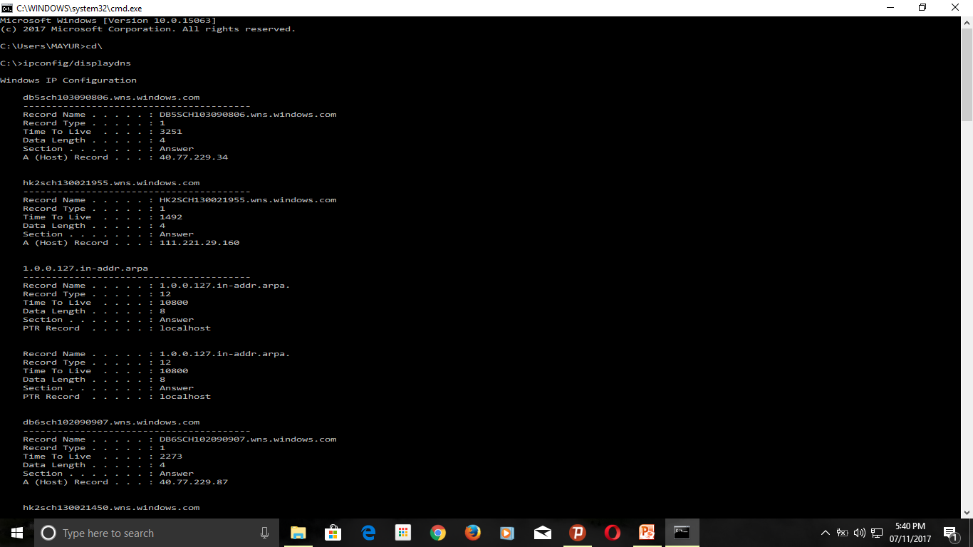
Step 1: ipconfig/displaydns Command will show all the DNS Resolver Cache information

Slide 12
Information you get after executing command
Domain Resolver Cache Gives Following Information:
Record Name : cached name
Record Type : is the type, displayed as a number - although more commonly they are referred to by their names.
Type 1 is "A" for an IPv4 address.
Type 28 is “AAAA” for an IPv6 address
Time To Live: is the time in seconds after which the cache entry must expire.
Data Length: Appears to be the length in bytes - an IPv4 address is four bytes, IPv6 is sixteen bytes.
A (Host) Record: IPv4 address

Slide 13
Method 2:Using browsing history Type I: Using User File System : We Get The Browser information Form User File System or from “C:\” drive.

Slide 14
File path Locations of Internet Browsers
1. Google Chrome :
History: C:\Users\SYSTEM_USER\AppData\Local\Google\Chrome\User Data\Default\
Cookie: C:\Users\SYSTEM_USER\AppData\Local\Google\Chrome\User Data\Default
Visited Links: C:\Users\SYSTEM_USER\AppData\Local\Google\Chrome\User Data\Default
Login Data: C:\Users\SYSTEM_USER\AppData\Local\Google\Chrome\User Data\Default
Session: C:\Users\SYSTEM_USER\AppData\Local\Google\Chrome\User Data\Default\Session Storage
File System: C:\Users\SYSTEM_USER\AppData\Local\Google\Chrome\User Data\Default\File System\Origins

Slide 15
history path of google chrome
Google Chrome : Put following path to get details of chrome
C:\Users\SYSTEM_USER\AppData\Local\Google\Chrome\User Data\Default\
Possible Attack:
Malicious activities are on rise. Hackers have managed to discover innovative ways to obtain personal, more sensitive information of the users.

Slide 16
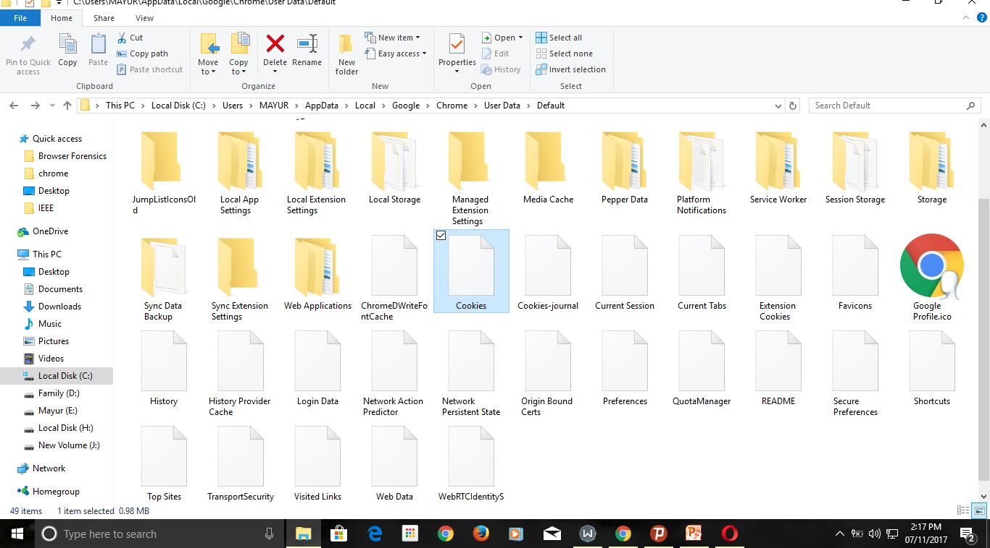
View all Details of Google Chrome

Slide 17
File path Locations of Internet Browsers
2. Mozilla Firefox :
History:
C:\Users\SYSTEM_USER\AppData\Roaming\Mozilla\Firefox\Profiles\ l7ohums2.default-1429948445160
Bookmarks: C:\Users\SYSTEM_USER\AppData\Roaming\Mozilla\Firefox\Profiles\l7ohums2.default-1429948445160\bookmarkbackups
Plugins: C:\Users\SYSTEM_USER\AppData\Roaming\Mozilla\Firefox\Profiles\l7ohums2.default-1429948445160\searchplugins
Sessions: C:\Users\SYSTEM_USER\AppData\Roaming\Mozilla\Firefox\Profiles\l7ohums2.default-1429948445160\sessionstore-backups
Cookies: C:\Users\SYSTEM_USER\AppData\Roaming\Mozilla\Firefox\Profiles\l7ohums2.default-1429948445160

Slide 18
history path of Mozilla Firefox browser
Mozilla Firefox :
C:\Users\SYSTEM_USER\AppData\Roaming\Mozilla\Firefox\Profiles\ l7ohums2.default-1429948445160
Possible Attack: Researchers warn hundreds of popular Firefox browser extensions are vulnerable to attack that could give hackers control of Mac OS X and Windows computers.

Slide 19
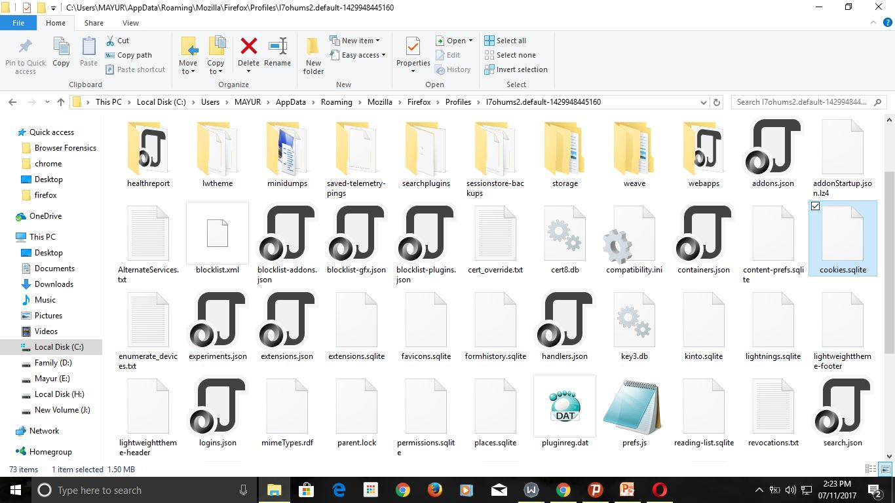
View all details of Mozilla Firefox

Slide 20
File path Locations of Internet Browsers
3. Internet Explorer :
Cache: C:\Users\SYSTEM_USER\AppData\Local\Microsoft\Windows\Caches
Thumb Cache: C:\Users\SYSTEM_USER\AppData\Local\Microsoft\Windows\Explorer
Layout: C:\Users\SYSTEM_USER\AppData\Local\Microsoft\Windows\Shell
Themes: C:\Users\SYSTEM_USER\AppData\Local\Microsoft\Windows\Themes
Notifications: C:\Users\SYSTEM_USER\AppData\Local\Microsoft\Windows\Notifications

Slide 21
history path of internet explorer browser
Internet Explorer :
C:\Users\SYSTEM_USER\AppData\Local\Microsoft\Windows\Caches
Possible attack: Not release new updates early so able hack the system

Slide 22
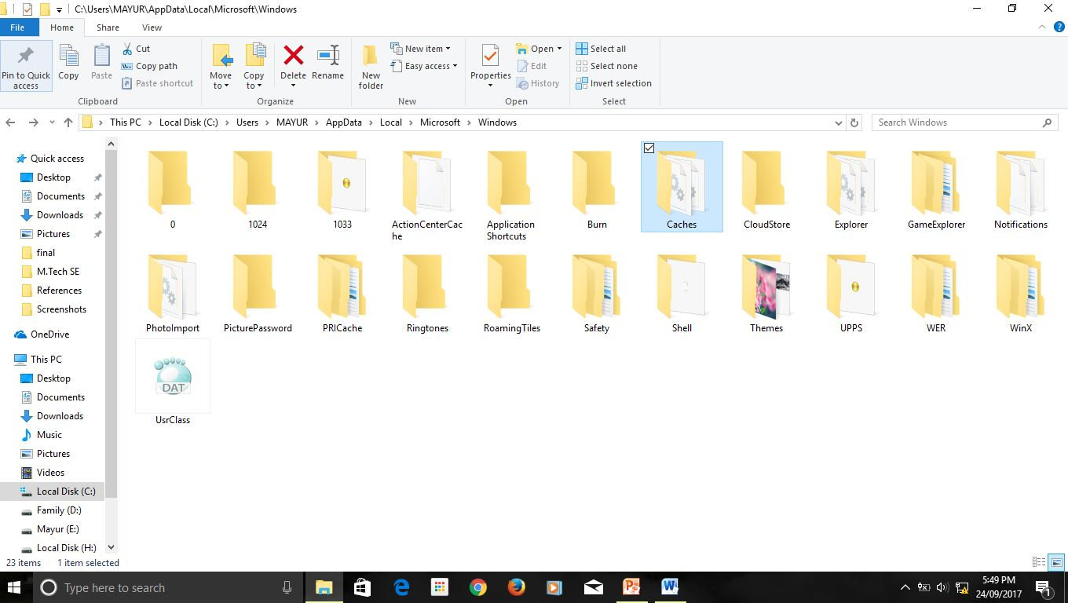
View all details of Internet Explorer

Slide 23
File path Locations of Internet Browsers
4. Safari:
Cookies: C:\Users\SYSTEM_USER\AppData\Roaming\Apple Computer\Safari\Cookies
Bookmarks: C:\Users\SYSTEM_USER\AppData\Roaming\Apple Computer\Safari
History: C:\Users\SYSTEM_USER\AppData\Roaming\Apple Computer\Safari
Session: C:\Users\SYSTEM_USER\AppData\Roaming\Apple Computer\Safari
Top Sites: C:\Users\SYSTEM_USER\AppData\Roaming\Apple Computer\Safari
Reading List: C:\Users\SYSTEM_USER\AppData\Roaming\Apple Computer\Safari

Slide 24
history path of apple safari
Safari:
C:\Users\SYSTEM_USER\AppData\Roaming\Apple Computer\Safari
Possible Attack: The safari browser is infected with a malicious virus attack.

Slide 25
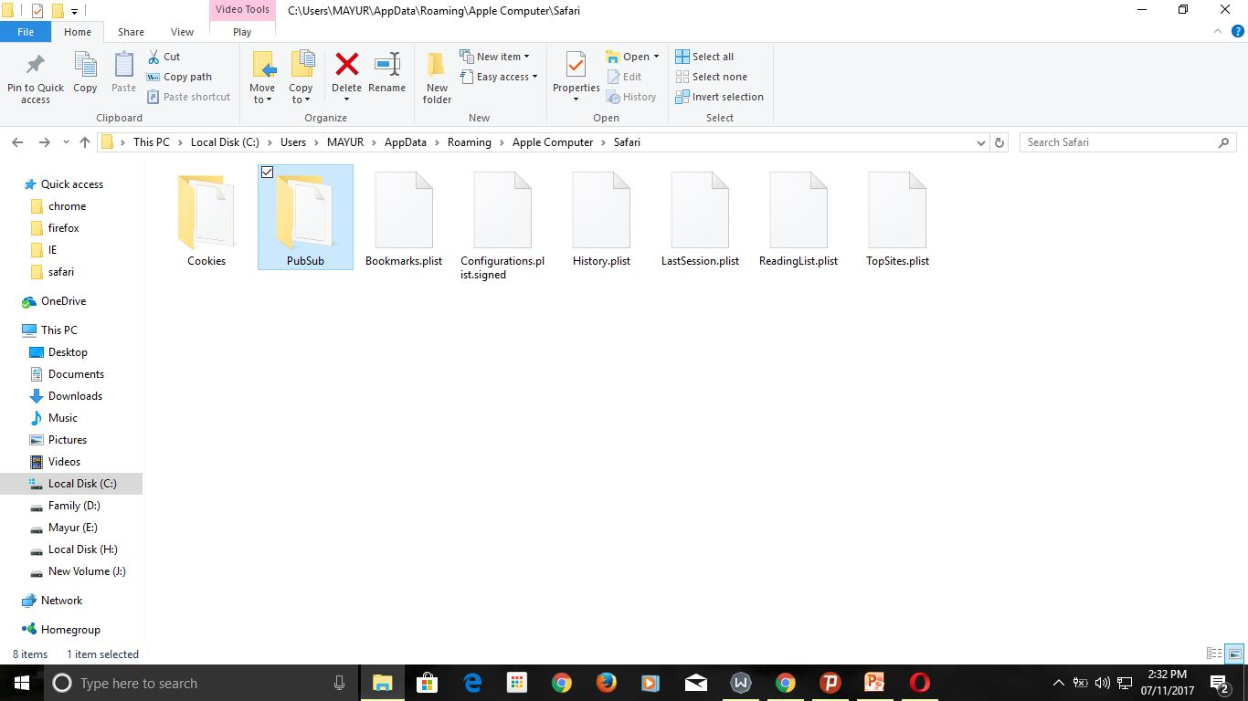
View all details of Apple Safari

Slide 26
File path Locations of Internet Browsers
5. Opera :
Cookies: C:\Users\MAYUR\AppData\Roaming\Opera Software\Opera Stable
Bookmarks: C:\Users\MAYUR\AppData\Roaming\Opera Software\Opera Stable
History: C:\Users\MAYUR\AppData\Roaming\Opera Software\Opera Stable
Session: C:\Users\MAYUR\AppData\Roaming\Opera Software\Opera Stable
Top Sites: C:\Users\MAYUR\AppData\Roaming\Opera Software\Opera Stable

Slide 27
history path of opera browser
Opera :
C:\Users\MAYUR\AppData\Roaming\Opera Software\Opera Stable
Possible Attack: Not release new updates early so able hack the system

Slide 28
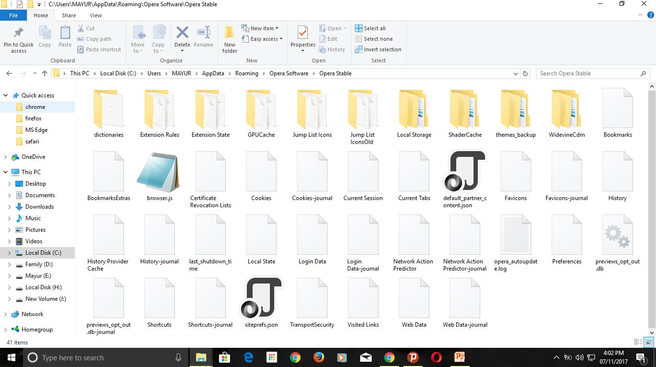
View all details of opera

Slide 29
File path Locations of Internet Browsers
6. Microsoft Edge :
History: C:\Windows\SystemApps\Microsoft.MicrosoftEdge_8wekyb3d8bbwe
Cookies: C:\Users\SYSTEM_USER\AppData\Local\Packages\Microsoft.MicrosoftEdge_8wekyb3d8bbwe\AC
Downloads: SYSTEM_USER\Downloads
Cache: C:\Users\SYSTEM_USER\AppData\Local\Packages\Microsoft.MicrosoftEdge_8wekyb3d8bbwe\AC\#!001\MicrosoftEdge
Log File Location: C:\Users\SYSTEM_USER\AppData\Local\Packages\Microsoft.MicrosoftEdge_8wekyb3d8bbwe\AC\MicrosoftEdge\User\Default\DataStore\Data\nouser1\120712-0049\DBStore\LogFiles
Favorite: C:\Users\SYSTEM_USER\AppData\Local\Packages\Microsoft.MicrosoftEdge_8wekyb3d8bbwe\AC\MicrosoftEdge\User\Default

Slide 30
history path of Microsoft edge
Microsoft Edge :
C:\Users\SYSTEM_USER\AppData\Local\Packages\Microsoft.MicrosoftEdge_8wekyb3d8bbwe\AC\MicrosoftEdge\User\Default\DataStore\Data\nouser1\120712-0049\DBStore\LogFiles
Possible Attack: Not release new updates early so able hack the system

Slide 31
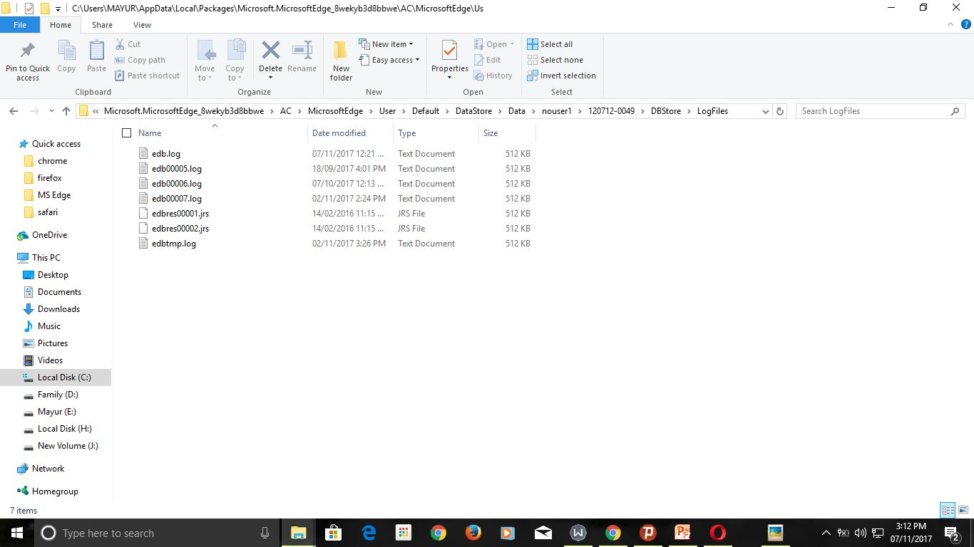
View all details of Microsoft Edge History

Slide 32
Method 2: Using browsing history Type II- Using Browser Cookies
Getting History From Browser History
We get the browsing history from browser, this store in various formats like Date/Time, Weekly, Monthly,
If we delete the history from system, we did not get this history form this source. We get history form other methods.

Slide 33
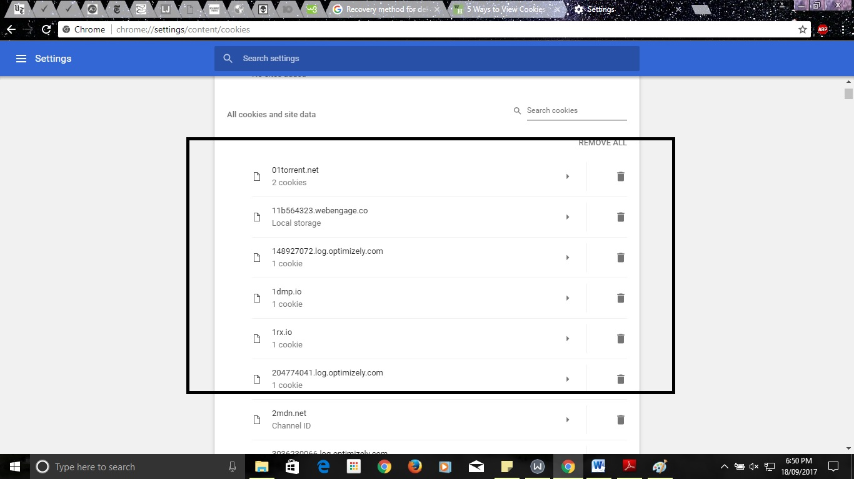
Details of google chrome Browser

Slide 34
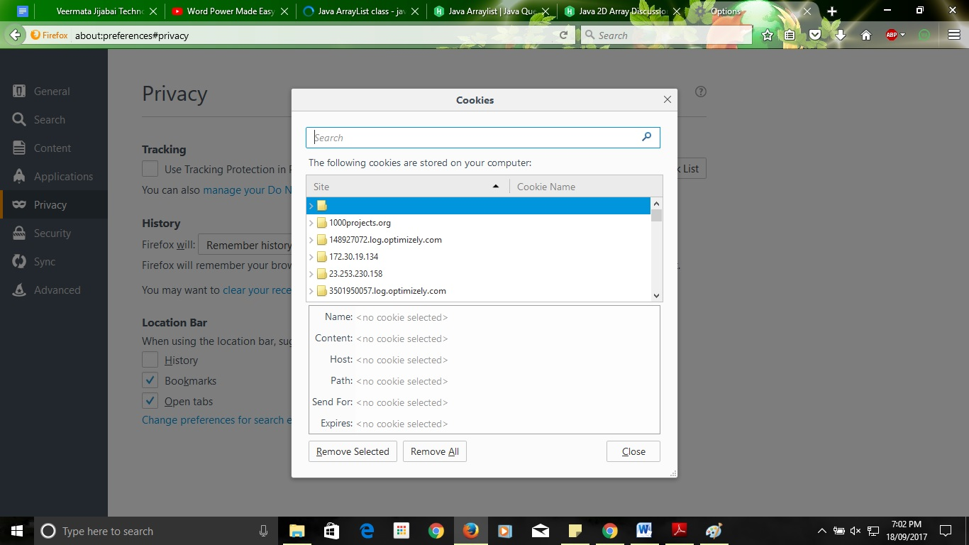
Details of Mozilla Firefox Browser

Slide 35
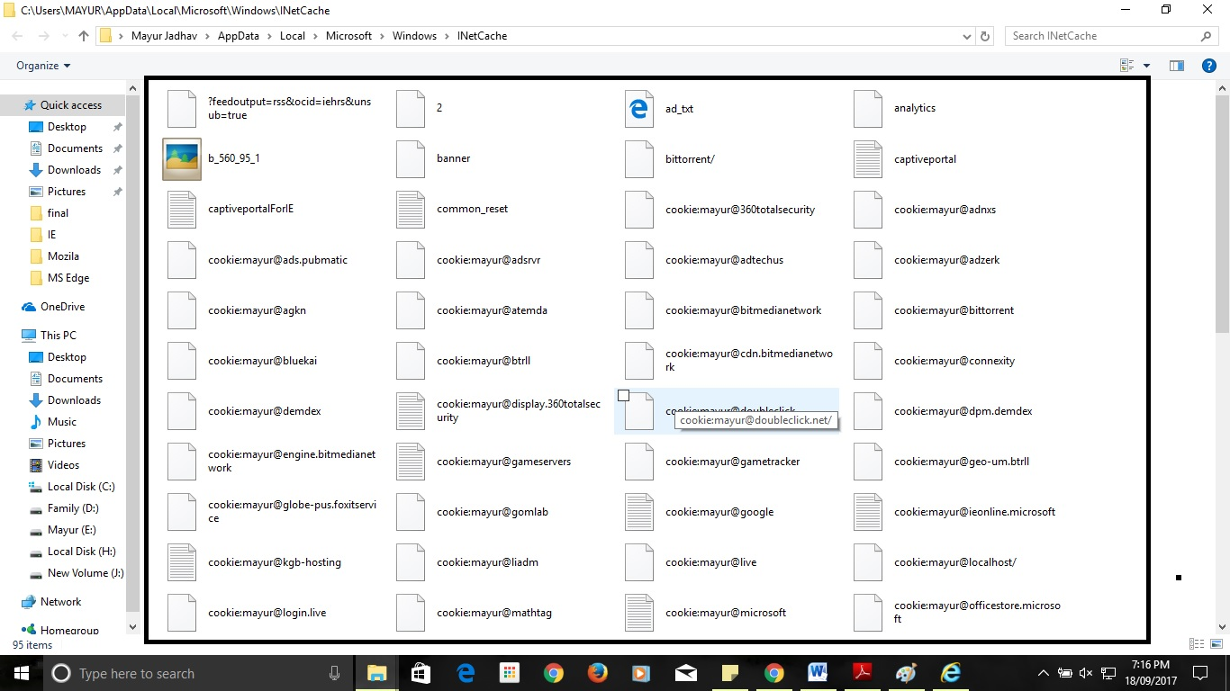
Details of Internet Explorer Browser

Slide 36
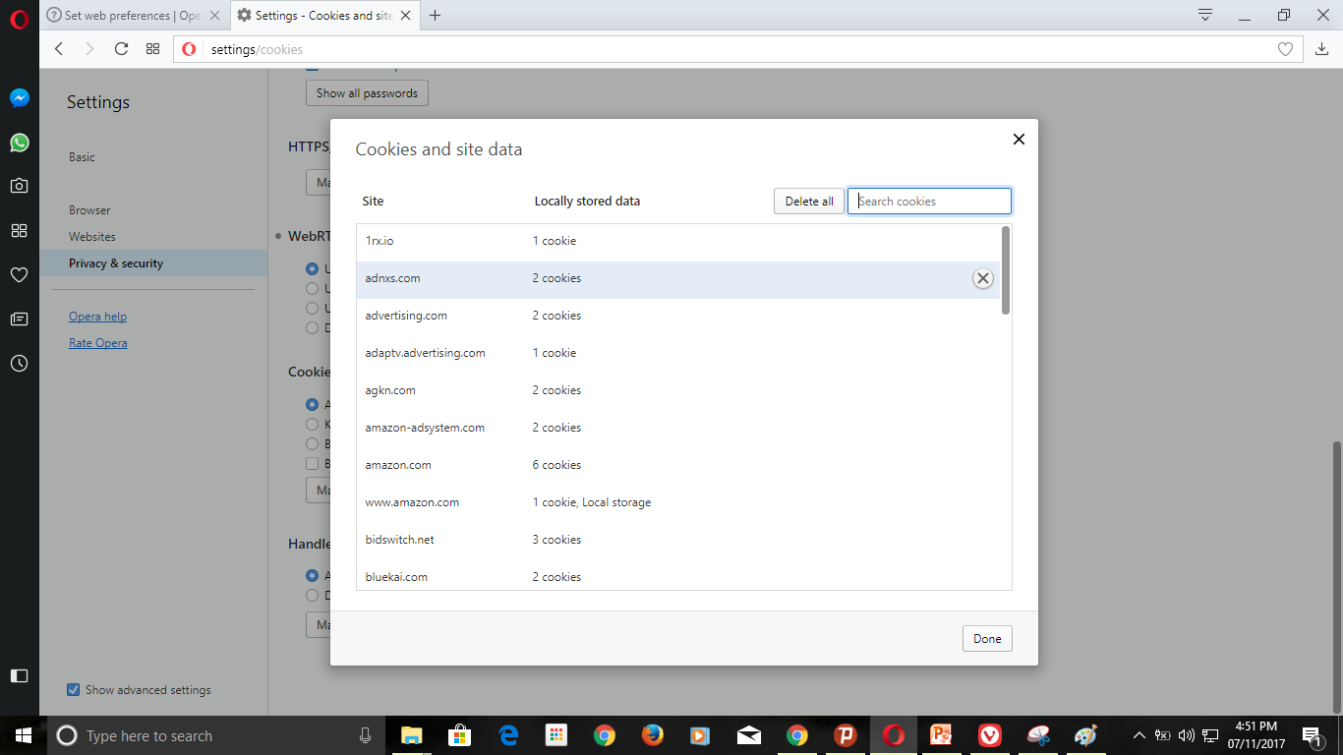
Details of Opera Browser

Slide 37
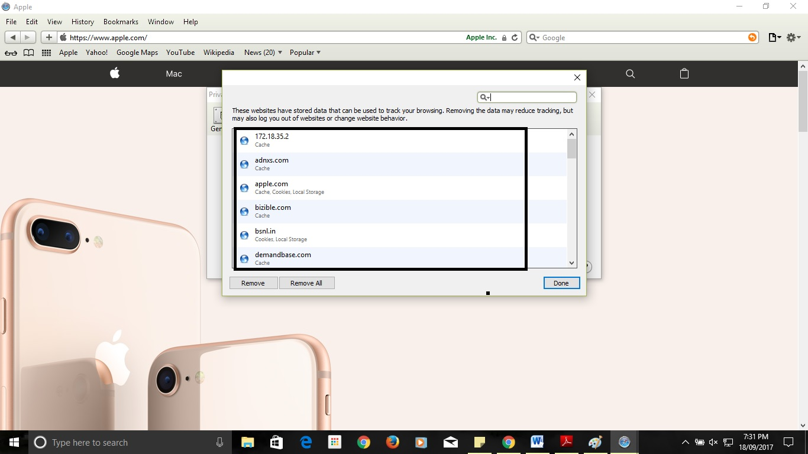
Details of Apple Safari Browser

Slide 38
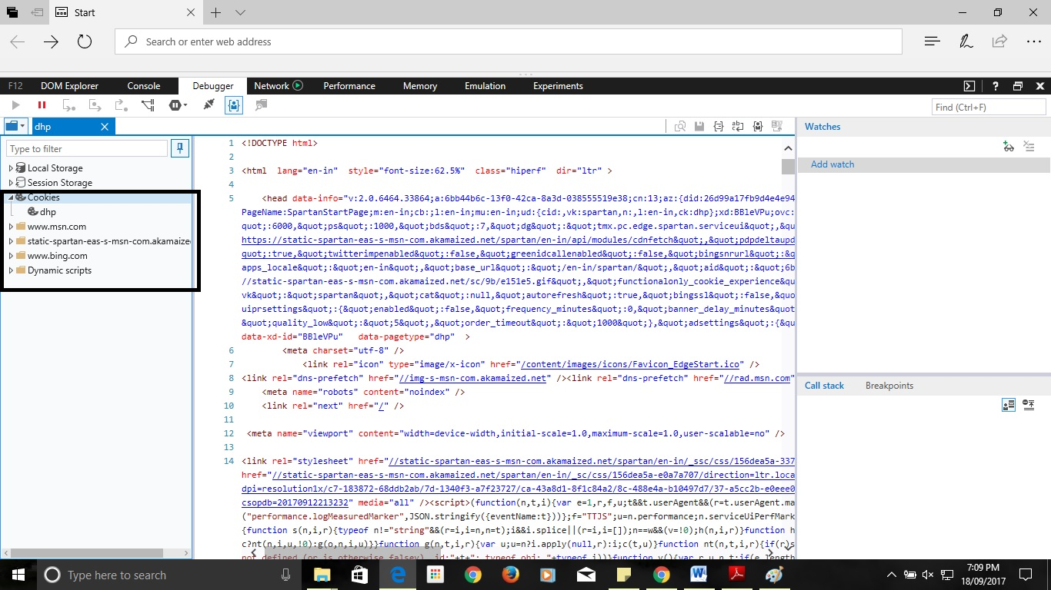
Details of Microsoft Edge Browser

Slide 39
Recover History From Google Account -
Method 3. Recover history from Google History
This is by far the easiest method but it will only work if you were signed in to your account during the browsing session you wish to access. Sign into your Google Account. Go to www.google.com/history and enter the information for the account that you were browsing with.
Review your browsing history. From this page you will be able to see your browsing history according to time and date. If you wish to delete your history, simply click on the cog icon in the upper-right hand corner of the screen and select “Remove Items.”

Slide 40
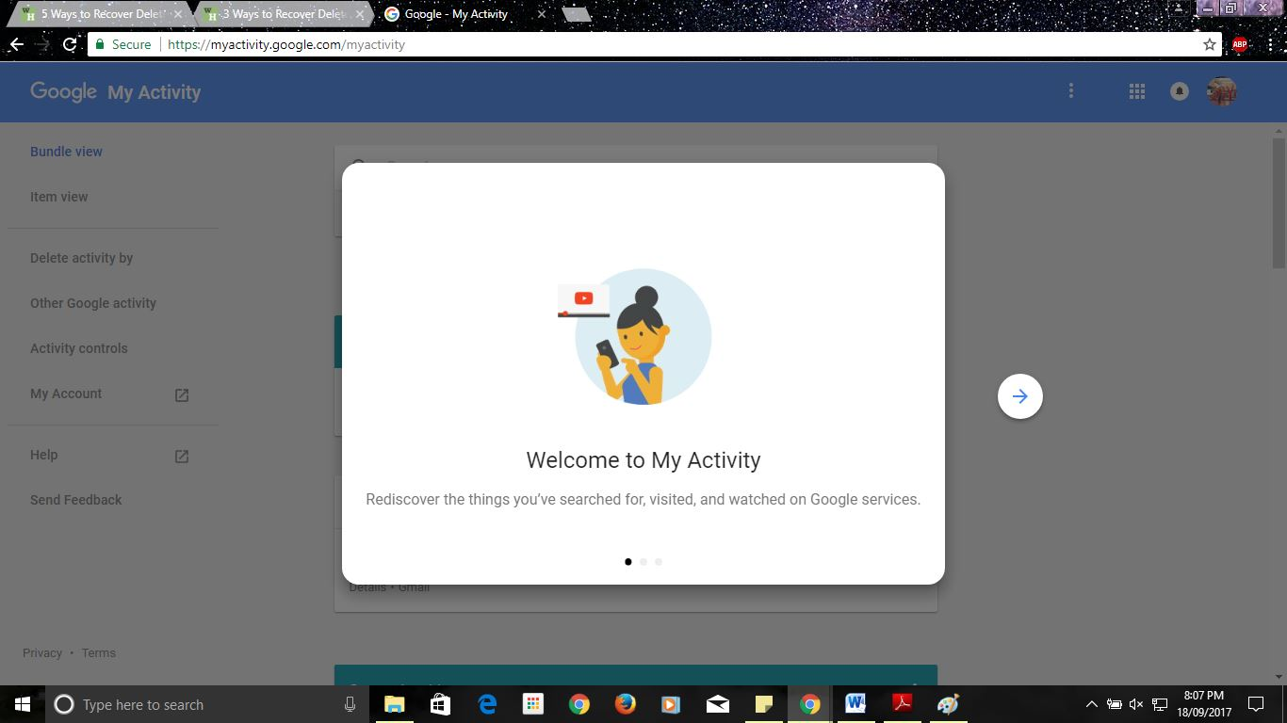
Step 1: type in url bar myactivity.google.com/myactivity

Slide 41
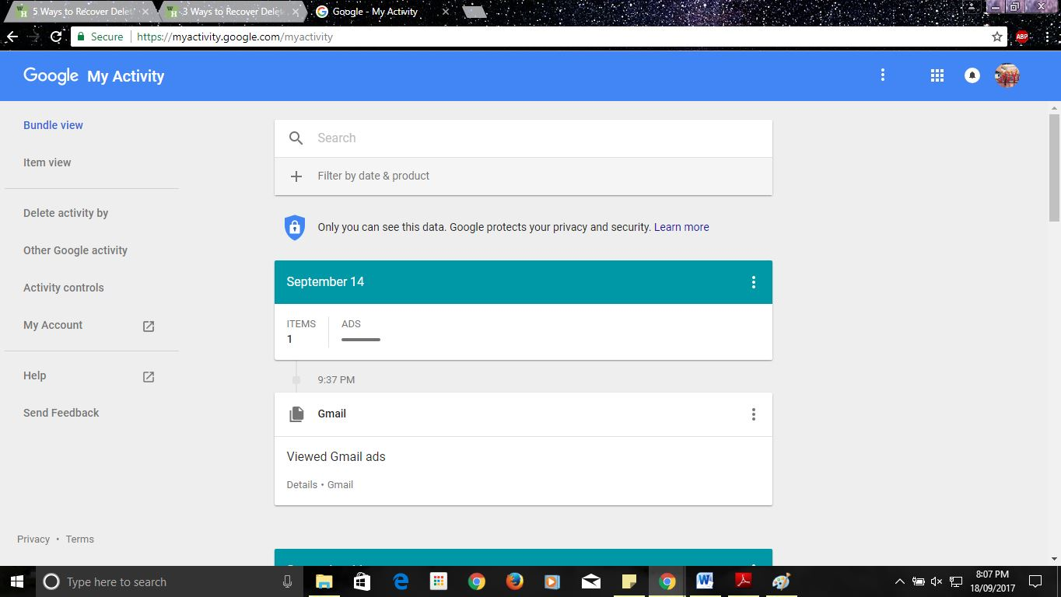
Step 2: view all user activity details in day by day format

Slide 42
Existing tools

Slide 43
Some existing tools of browser forensic
Autopsy –
Autopsy is a digital forensic platform for Windows and Linux. It provides the facility for data carving, timeline analysis, and web artifact analysis. The autopsy extracts the web history, cookies, bookmarks from Firefox, Chrome and IE.
Features:
1) Easy to Use
2) Web Browser Forensic

Slide 44
2) Browser History Examiner –
The Browser History Examiner analyzes web history for chrome, firefox, internet explorer web browser on the Windows platform. Browser History Examiner is a forensic software tool for capturing, extracting and analysing internet history from the main desktop web browsers. Many types of data can be analysed including website visits, searches, downloads and cached files.
Features:
1) Website Activity Timeline
2) Cached Web Page Viewer
3) Internet Search History
4) Reporting and Data Export

Slide 45
3) NetAnalysis –
NetAnalysis is a state-of-the-art application for the extraction, analysis and presentation of forensic evidence relating to Internet browser and user activity on computer systems and mobile devices.
Fetures –
1) Web Browser Forensics
2) Filtering And Searching
3) Cache Export And Page Rebuilding
4) Reporting

Slide 46
4) Internet Evidence Finder –
Internet Evidence Finder (IEF) is a computer forensics software product that can recover data from a hard drive, live RAM, or files for Internet-related evidence. IEF was designed with digital forensics examiners in mind, IEF is also used extensively by personnel in IT information security, electronic discovery, cyber security, and corporate investigations.
Features:
1) Web Browser Forensic
3) Web cache history
4) Full Web browser artifacts

Slide 47
Flow of system

Slide 48
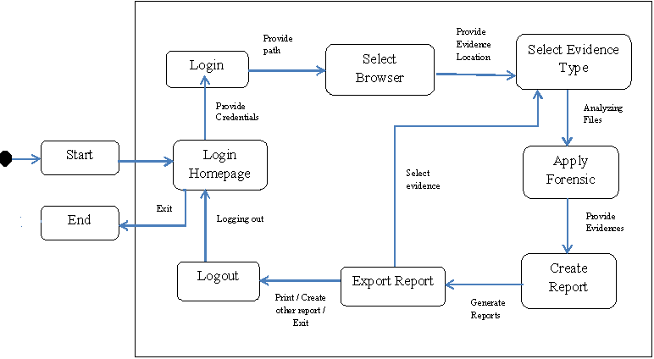
Figure – Flow of system

Slide 49
Implementation Screenshots

Slide 50
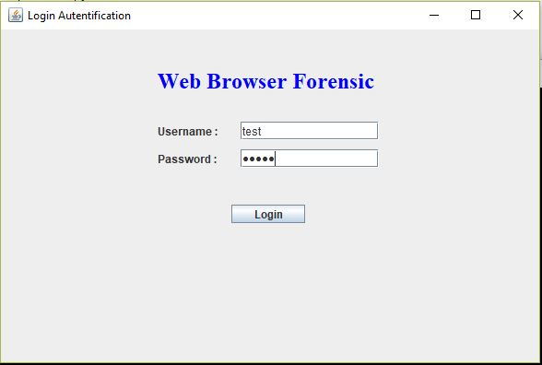
1. Login Page
This is Login page of system.
This is entry point of the system

Slide 51
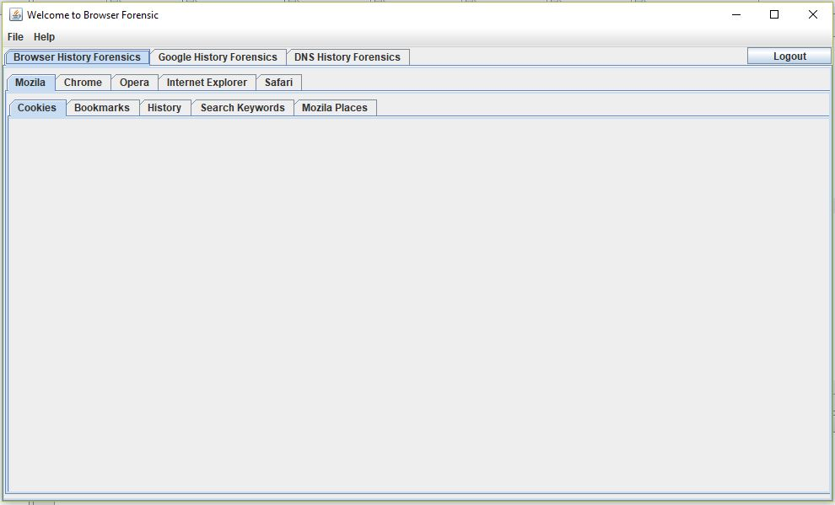
2. Mainpage
This is Home page of system.
This will provides the 3 methods to recover the data if any data is lost by user or deleted by the system user.

Slide 52
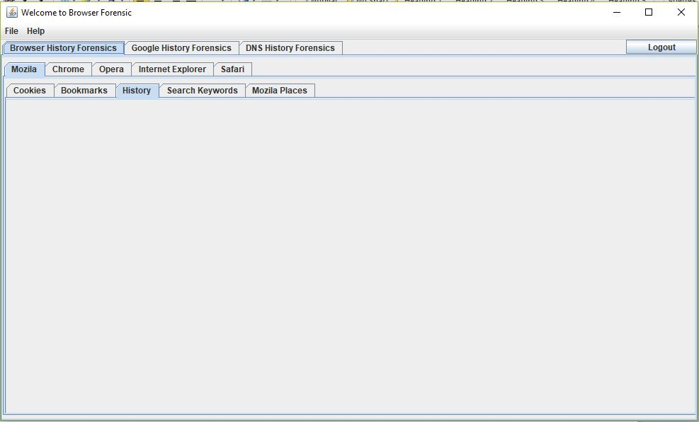
3.Forensic of Mozilla Firefox browser
This window for forensic of Mozilla Firefox browser.
This will gives the 5 different evidences For the forensic.
This are Cookies, Bookmarks, History, Search Keywords, Mozilla Places.

Slide 53
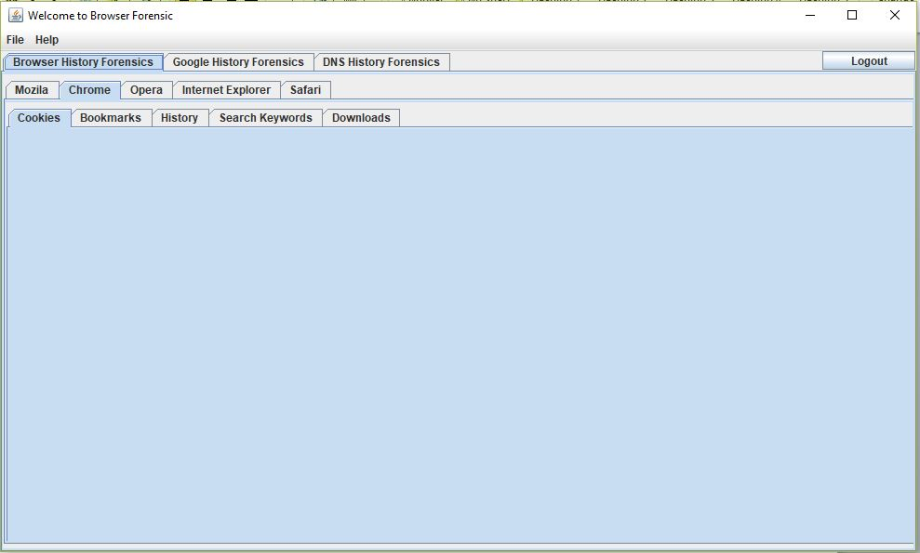
4.Forensic of google chrome browser
This window for forensic of Google Chrome browser.
This will gives the 5 different evidences For the forensic.
This are Cookies, Bookmarks, History, Search Keywords, Downloads.

Slide 54
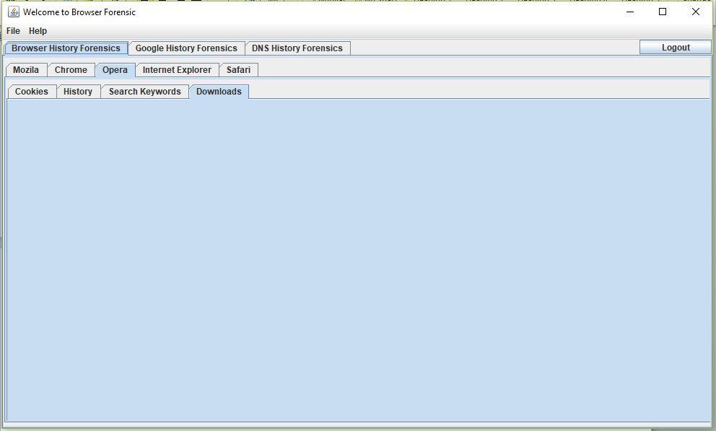
5.Forensic of opera browser
This window for forensic of Opera browser.
This will gives the 4 different evidences For the forensic.
This are Cookies, History, Search Keywords, downloads.

Slide 55
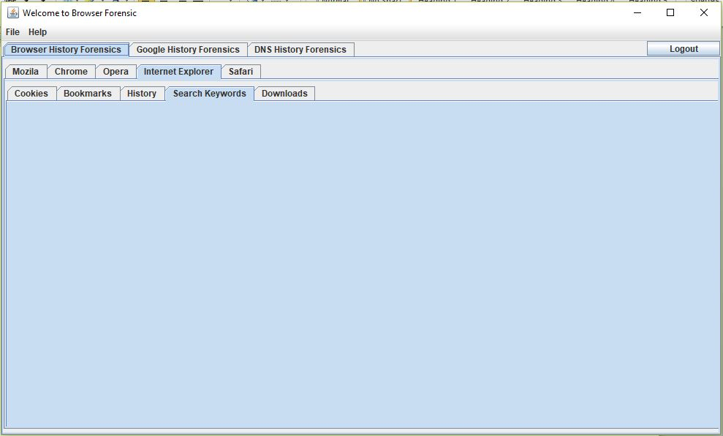
6.Forensic of internet explorer browser
This window for forensic of Internet Explorer browser.
This will gives the 5 different evidences For the forensic.
This are Cookies, Bookmarks, History, Search Keywords, Downloads.

Slide 56
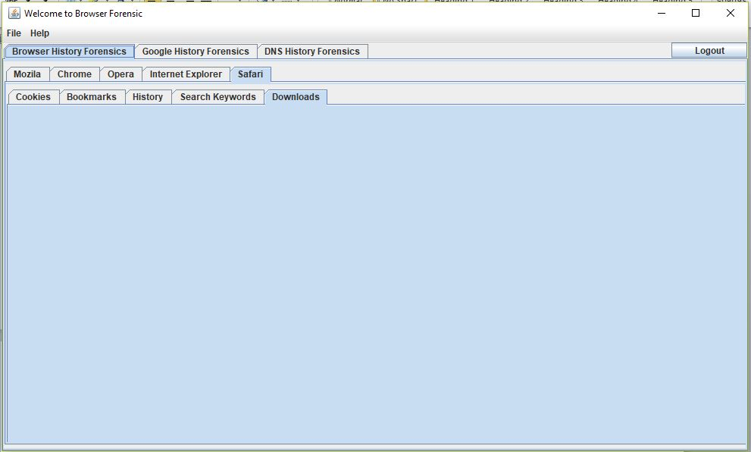
7. .Forensic of apple safari browser
This window for forensic of Apple Safari browser.
This will gives the 5 different evidences For the forensic.
This are Cookies, Bookmarks, History, Search Keywords, Downloads.

Slide 57
References
Wade Alcorn,Christian Frichot ,Michele Orru, “The Browser Hacker’s Handbook”, WILEY Publication.
Keith J. Jones,”Forensic Analysis of Internet Explorer Activity Files”,.
Erhan Akbal, Fatma Güneş, Ayhan Akbal,”Forensic Analysis of Web Browser Records”, Journal of Software 2016.
Sherri David off Jonathan Ham, “Network Forensics Tracking Hackers through Cyberspace”, Pearson Publication,2012.
Junghoon Oh , Seungbong Lee , Sangjin Lee,“Advanced evidence collection and analysis of web browser Activity”,Digital Investigation.
Andrew Marrington, Ibrahim Baggili, Talal Al Ismail, Ali Al Kaf, ”Portable Web Browser Forensics .
Murilo Tito Pereira,”Forensic analysis of the Firefox3 internet history and recovery of deleted SQLite records”, Sciencedirect,2009.

Slide 58
Taub, Eric A. (2006-04-05), "Deleting may be easy, but your hard drive still tells all“,New York Times. Retrieved 2009-01-11
Springer Open Journal, “Do private and portable web browsers leave incriminating
evidence?: a forensic analysis of residual artifacts from private and portable web
browsing sessions”, Donny J Ohana and Narasimha Shashidhar.
10. http://www.linuxjournal.com/content/creating-centralized-syslog-server - Syslog server information.
11. http://web.iiit.ac.in/~mayank.natani/central-logging-server/ - Linux system logging mechanism that records all the system activities. These logs are very critical for system admin for troubleshooting purpose. The target is to build a central logging server which could be used automatically to save all the logs of client machines.
12. http://www.toptenreviews.com/software/internet/best-internet-browser-software/ - The Best Internet Browser Software of 2017
13. http://whatismyipaddress.com/proxy-server - What is IP? Why it is needed? How it works?
14. http://www.forensicfocus.com/Content/pid=97/page=1/ - IDS related information.

Slide 59
15. https://www.symantec.com/connect/articles/web-browser-forensics-part-1
- Forensic tools and it’s details.
16. https://www.symantec.com/connect/articles/web-browser-forensics-part-2
- Forensic tools and it’s details.
17. http://www.wikihow.com/View-Cookies – How to view cookies?
18. https://www.easeus.com/computer-instruction/recover-browser-internet-history.html - How to Recover Browser/Internet History?
19. “Web Browser Analysis for Detecting User Activities”, Library Journal
20. Varsha Karbhari Sanap ,Vanita Mane ,”Comparative Study and Simulation of Digital Forensic Tools”, International Journal of Computer Applications ,2015.

Slide 60
Thank You

